Slide 3
The Excretory System

Slide 4
Excretion
Excretion is the process whereby harmful products are removed from the body
Body processes like digestion, respiration, circulation and breathing produce waste products like excess water, excess salts, nitrogenous wastes and carbohydrates

Slide 5
Human excretory organs
The skin
The lungs
The kidneys

Slide 6
Main excretory organs and their wastes
organ
Waste product
Skin
Lungs
kidney
Sweat
Carbon dioxide and water
urine

Slide 7
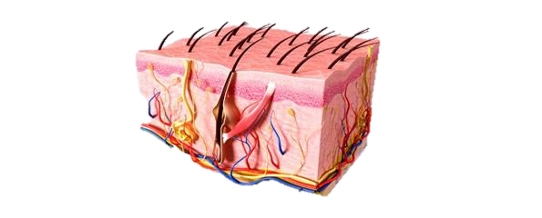
The skin

Slide 8
Skin
The skin consists of two layers: dermis which is the inner layer and the epidermis which is the outer layer
Opening on the skin are known as pores
Sweat glands which are coiled tubes contain blood vessels which transport waste products from other body parts
Sweat produced is stored in the sweat glands
Sweat from sweat glands goes through the epidermis to the outside of the skin through a pore called sweat pores
Sweat cools out bodies because it absorbs heat from our bodies as it evaporates

Slide 9
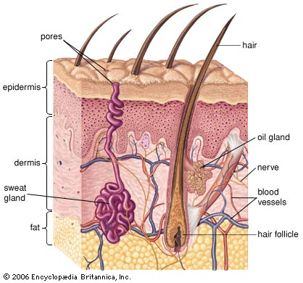
Structure of the skin

Slide 10
The lungs
Lungs are made of tiny elastic sacs held together by a thin wall
Lungs are elastic and can therefore contract and expand to expel and inhale air during breathing
Waste products excreted through the lungs are carbon dioxide and excess water
Excess water is breathed out in form of vapour
When blood rich in carbon dioxide reaches the alveoli, carbon dioxide moves from the blood to the air sacs and is breathed out as waste

Slide 11
The kidneys
They are two beans like structure
There is right and left kidney
Kidney filters blood and removes excess water excess salt and urea which form urine
Urine formed is then passed through ureter to the bladder where it is stored
When bladder gets full, urine is discharged out through urethra

Slide 12
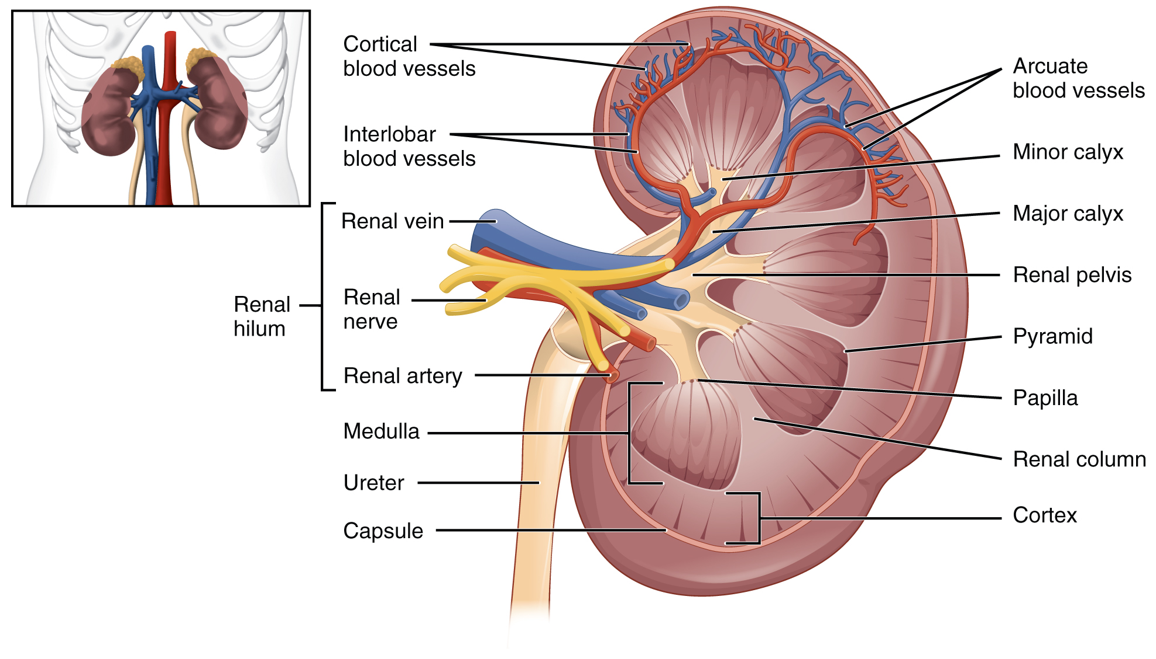
Anatomy of the kidney

